Slide 1


Citation Classification Using Graph Diffusion Models
Department of Software Engineering Capstone Project Phase A Braude College of Engineering, Israel Project 24-2-R-4
Students:
Roei Nizri – RoeiNizri1@gmail.com, 318260742
Ran Polac – RanPolac@gmail.com, 318265808
Supervisors: Dr. Renata Avros, Prof. Zeev Volkovich

Slide 2
Graph Diffusion for Anomaly Detection
Introduction
The problem
Project Motivation and Objectives
Background and Related Work
Methodology
Engineering Process
Product
Testing and Evaluation
Results
Discussion
Future Work
Conclusion

Slide 3
Introduction
Definition: Anomaly detection on graphs presents significant challenges, primarily due to label imbalance and data insufficiency.
Real-World Significance: Effective detection enhances security, fraud prevention, and system integrity across diverse sectors like finance and healthcare.
Key Challenges: Challenges include handling large datasets, maintaining scalability, and distinguishing genuine anomalies from normal fluctuations. Early methods were designed to handle simpler graph structures but struggled with more complex, dynamic graphs.
This can lead to incomplete representations of data, resulting in deteriorated overall performance.
Notes:
Today we will talk about anomaly detection on graphs.
Definition: It’s about finding unusual patterns in graph data, which is challenging due to limited and unbalanced data.
Real-World Significance: This is crucial for enhancing security, preventing fraud, and maintaining system integrity, especially in sectors like finance and healthcare.
Key Challenges: Challenges include handling large datasets, scaling efficiently, and distinguishing real anomalies from normal variations, especially in complex graphs.
Conclusion: These challenges can lead to incomplete data and reduced effectiveness in anomaly detection.
Now, let’s explore how to address these issues.

Slide 4
Problem Explanation:
Complexity :Academic networks consist of vast and complex datasets with intricate relationships between publications and authors. Detecting anomalies in citations is challenging due to:
1
Volume: The sheer volume of publications and the complexity of citation networks make it difficult to process and analyze data efficiently.
2
Scalability: Ensuring that our detection methods can scale with the growth of academic publications is crucial.
3
Distinguishing Anomalies: Differentiating between legitimate citation behaviors (such as self-citations or collaborative citation clusters) and true anomalies requires sophisticated techniques to avoid false positives and ensure accuracy.
4
Notes:
Now, let's discuss the challenges in anomaly detection using the Cora dataset.
Complexity: First, complexity. The Cora dataset has intricate relationships between academic papers. Detecting anomalies is tough because these relationships are complex and intertwined.
Volume: Second, volume. The dataset contains a large number of papers and citations, making it challenging to efficiently process and analyze the data for anomalies.
Scalability: Third, scalability. As the dataset grows, with more papers and citations, our detection methods need to scale effectively to handle this increasing size.
Detecting citations: Finally, detecting citations. For example, differentiating between common citation patterns and unusual, potentially suspected citations is crucial to avoid false positives.
These challenges highlight why anomaly detection in the Cora dataset is both difficult and essential."

Slide 5
Approach
Our approach leverages advanced graph diffusion models and synthetic anomaly nodes to improve detection citations, aiming to uphold the integrity of academic research. The model uses nodes
researchers have developed various algorithms that leverage the structural properties of graphs.
To address this issues, the study introduces a diffusion model-based graph generator capable of simultaneously producing graph structures and node features in a multitask fashion, focusing on generating synthetic anomalous examples.
By integrating these synthetic anomalies into the training dataset, we achieve a more balanced dataset, significantly enhancing the training and performance of downstream anomaly detection models.
The approach addresses the challenges of label imbalance and data insufficiency in graph anomaly detection, providing a robust framework for generating synthetic anomalies and improving the effectiveness of anomaly detection models.
Notes:
"Our approach uses advanced graph diffusion models and creates synthetic anomalies to improve detection.
We developed a model that generates both graph structures and fake anomalies (synthetic anomalies) at the same time.
By adding these fake anomalies to our dataset, we make the training more effective and improve the performance of our detection models.
This method helps us deal with issues like unbalanced data and not enough examples, making our anomaly detection more reliable."

Slide 6
Expected achievements
The anticipation is that the model will be able to accurately capture complex inherent dependencies and distributions in graph data.
The model will efficiently process and analyze vast graph datasets, validating its scalability.
The purpose is to provide an accessible tool for graph generation with possible applications to suspected citations in graph-structured data, ensuring data integrity and providing insights.
Notes:
"Here’s what we expect to achieve with our approach:
First, we anticipate that the model will accurately capture the complex patterns and distributions in graph data.
Second, the model should efficiently process and analyze large graph datasets, proving its scalability.
Finally, our goal is to create a useful tool for generating graphs, which can be applied to detect suspected citations in graph-structured data, ensuring data integrity and providing valuable insights."

Slide 7
Project Motivation and Objectives
Motivational Framework: Graph diffusion models offer a robust mechanism to capture complex relationships, essential for effective anomaly detection.
Objective Clarity: The primary objective is enhancing detection accuracy while accommodating diverse graph structures and sizes seamlessly.
Application Enhancements: Focused on improving real-time analysis capabilities, fostering timely responses in critical applications across industries.
Notes:
"Our project is driven by three main factors:
Motivational Framework: We’re using graph diffusion models because they effectively capture complex relationships, which is crucial for accurate anomaly detection.
Objective Clarity: Our main goal is to improve detection accuracy while handling various graph structures and sizes smoothly.
Application Enhancements: We’re focused on enhancing real-time analysis, ensuring quick responses in critical applications across different industries.
These points outline why we’re doing this project and what we aim to achieve."

Slide 8

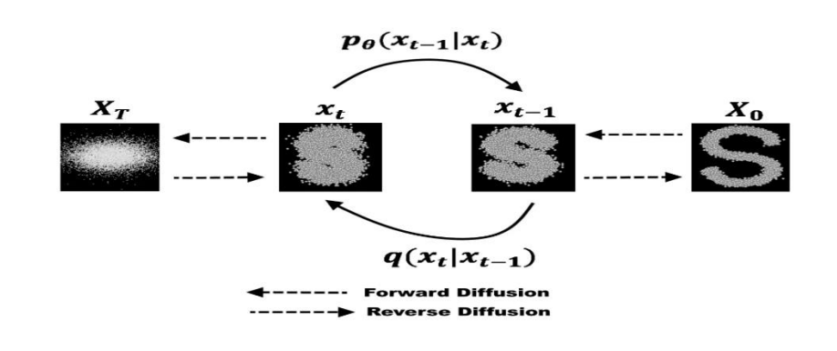
Diffusion models
Diffusion models were introduced in 2015 as a method to learn a model that can sample from a highly complex probability distribution
The model has the ability to generate realistic graph structures and node features, which can be used to create synthetic anomalies.
operates by adding noise to data points and then learning to reverse this process, effectively generating data points from noise.
Notes:
Alright, we want explain it in a simple way.
imagine you have a really cool machine that can learn from pictures and create new ones that look similar.
But sometimes, it gets confused because the pictures are so tricky.
So, some smart people made another machine to help.
This new machine is called a diffusion model.
Here's how it works: First, imagine a big room where you start with a simple picture.
Then, this diffusion model slowly changes the picture step by step.
Each step adds a little bit of randomness, like adding tiny dots or lines.
This makes the picture look more like the tricky ones you want to make.
The diffusion model is like a game where you start with a very clear picture and then play a game where each step makes it a bit more blurry or different.
But it's a smart game because it knows how to make the changes just right.
It uses math called Gaussian transitions to decide how much to change the picture at each step.
The best part is, this new machine can also learn by itself!
It looks at many pictures to figure out how much it should change each time.
And when it's done learning, it can make new pictures that look really tricky, just like the ones it learned from
So, this diffusion model helps the first machine make even better pictures by learning how to change them in just the right way.
And that's how these smart people are making sure their machines can make the best pictures possible

Slide 9
Pre-processing
The purpose goal is to enrich the dataset with synthetic anomaly nodes for robust training of anomaly detection systems. These synthetic nodes include four key components: Node Feature: Represents various attributes associated with the node, such as metrics or characteristics that describe its properties and behavior within the graph. Node Timestamp: A temporal marker indicating when a specific event or interaction involving the node occurred, crucial for analyzing the temporal dynamics of the network.
Positive Label: A binary indicator denoting the anomaly nature of the node, used to differentiate between normal and anomalous behavior for training and validating detection models.
Heterogeneous Graph Structure: Different types of nodes and edge connections.
Notes:
These synthetic nodes have four key components:
Node Feature: This includes attributes like metrics or characteristics that describe the node’s properties and behavior within the graph.
Node Timestamp: This is a time marker that shows when an event involving the node happened, which helps analyze the network’s temporal dynamics.
Positive Label: A binary indicator that marks whether the node is an anomaly, which is essential for training and validating our detection models.
Heterogeneous Graph Structure: This includes different types of nodes and their connections, adding complexity to the graph.
These components together help create a more robust and effective training process for anomaly detection."

Slide 10
Engineering Process
Dataset Preparation: Data collection involved identifying relevant graphs and pre-processing steps such as normalization and feature selection.
Graph Construction: Constructed directed and undirected graphs reflecting relationships, emphasizing edge weights and node attributes for accurate analyses.
Anomaly Detection Workflow: Implemented a structured workflow blending graph autoencoders with diffusion models to systematically identify and analyze anomalies.
Notes:
"Our engineering process consists of three main steps:
Dataset Preparation: We began by collecting relevant graphs and pre-processing them through steps like normalization and feature selection to ensure the data is ready for analysis.
Graph Construction: Next, we constructed both directed and undirected graphs that reflect relationships within the data, paying special attention to edge weights and node attributes to make our analyses more accurate.
Anomaly Detection Workflow: Finally, we implemented a structured workflow that combines graph autoencoders with diffusion models to systematically identify and analyze anomalies in the data.
This structured process ensures our approach is thorough and effective."

Slide 11
Methodology
Graph Autoencoder Overview:
Graph autoencoders utilize encoding-decoding processes to transform heterogeneous graph structures into latent representations.
Encoding Heterogeneous Graphs:
The encoding phase captures diverse node features and relationships, enabling effective aggregation of varying data types.
Diffusion in Latent Space:
Incorporating noise addition and reversal enhances model robustness, facilitating improved anomaly detection capabilities via diffusion models.
Timestamp Generation:
The model generates timestamps to ensure the temporal context is preserved within the latent representations.
Diffusion Model Application:
The diffusion model leverages the latent space representations to detect anomalies, applying techniques that enhance the model's detection accuracy.
Notes:
"Our methodology involves several key steps:
Graph Autoencoder Overview: We use graph autoencoders, which transform complex graph structures into simpler latent representations through encoding and decoding.
Encoding Heterogeneous Graphs: During encoding, we capture diverse node features and relationships, which allows us to effectively aggregate different types of data.
Diffusion in Latent Space: By adding and reversing noise in the latent space, we enhance the robustness of our model, improving its ability to detect anomalies.
Timestamp Generation: We generate timestamps to maintain the temporal context within the latent representations, ensuring accurate analysis over time.
Diffusion Model Application: Finally, the diffusion model uses these latent representations to detect anomalies, applying techniques that boost the model's detection accuracy.
This methodology combines several advanced techniques to improve the effectiveness of anomaly detection."

Slide 12
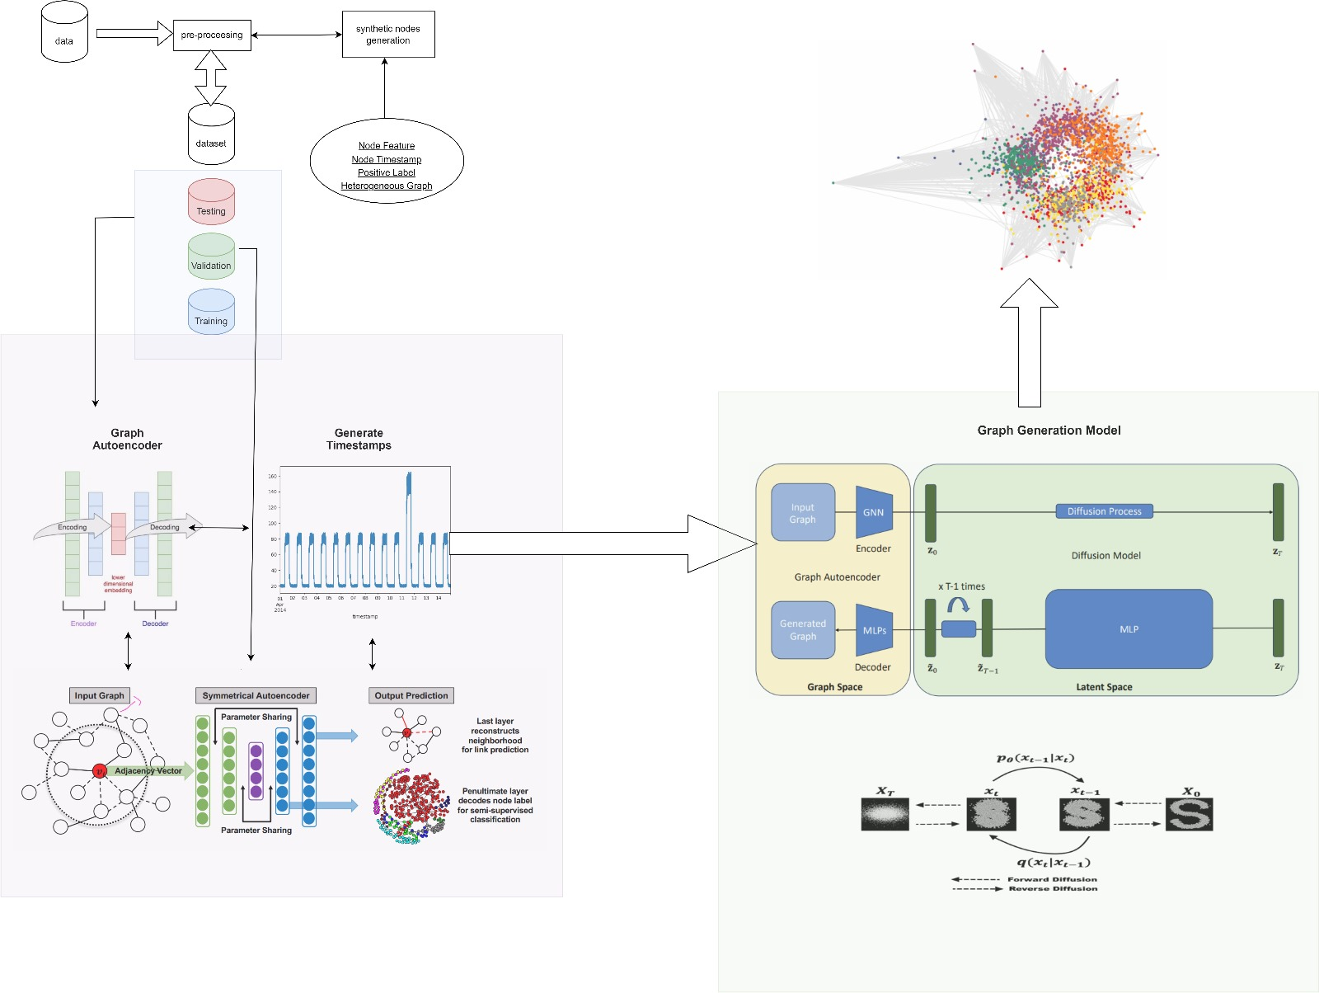
The general process Anomaly Detection Using Synthetic Nodes, Graph Autoencoders, and Diffusion Techniques
Notes:
"This slide visualizes the overall process of anomaly detection using synthetic nodes, graph autoencoders, and diffusion techniques.
Data and Pre-processing: We start with data collection and pre-processing, where we prepare the dataset and generate synthetic nodes with features like node features, timestamps, and labels.
Graph Autoencoder: The input graph is fed into a graph autoencoder, which encodes the graph structure and node features into a latent space. The autoencoder also generates timestamps, maintaining temporal context in the data.
Diffusion Techniques: The encoded data is then processed through a diffusion model, which refines the latent space, making the detection of anomalies more robust.
Output and Analysis: Finally, the processed data is analyzed, and the results are used to identify and understand anomalies in the graph.
This process integrates several advanced techniques to enhance the accuracy and reliability of anomaly detection."

Slide 13
Results
Improved Accuracy: Experiments demonstrate a notable increase in anomaly detection accuracy, surpassing traditional models across diverse datasets.
Enhanced Robustness: The approach showcases improved robustness against false positives, effectively adapting to complex and varying graph structures.
Real-World Impact: Findings indicate substantial implications for real-world applications, enhancing reliability in critical systems and processes.
Notes:
"Our results show three main points:
Improved Accuracy: We saw a big boost in accuracy, better than traditional models across different datasets.
Enhanced Robustness: Our approach is more robust, with fewer false positives and better handling of complex graphs.
Real-World Impact: These results mean our method can make systems more reliable in real-world applications.
Overall, our approach clearly improves citations detection."

Slide 14
Discussion
Advantages Over Existing Methods: Proposed approach utilizes complex relationships, leading to higher accuracy and lower false positive rates.
Cross-Domain Applications: Potential applications include cyber security, fraud detection, healthcare monitoring, and smart city management.
Scalability Benefits: The model effectively handles large-scale datasets, maintaining performance across various graph structures and sizes.
Notes:
"Our discussion focuses on three key points:
Advantages Over Existing Methods: Our approach uses complex relationships, which leads to higher accuracy and fewer false positives compared to traditional methods.
Cross-Domain Applications: This method can be applied across various fields, including cybersecurity, fraud detection, healthcare monitoring, and smart city management.
Scalability Benefits: The model handles large datasets effectively, maintaining performance across different graph structures and sizes.
These points highlight the strengths and versatility of our approach."

Slide 15
Testing and Evaluation
Evaluation Metrics: Key metrics include AUROC and AUPRC, measuring model performance in classifying anomalies effectively across datasets.
Performance Comparison: Proposed method's efficiency is benchmarked against baseline models to ensure superior anomaly detection capabilities quantitatively.
Dataset Results: Results vary significantly across datasets; detailed analysis elucidates how different structures impact model performance metrics.
In order for the project to be successful it needs to detection 90% of the suspected ciatations between the graphs.
If the result is less than 90% the model needs to be fine-tuned and further tests will be conducted.
Notes:
"In the testing and evaluation phase, we focus on three main areas:
Evaluation Metrics: We use key metrics like AUROC and AUPRC to measure how well the model classifies anomalies across different datasets.
Performance Comparison: We compare our method's efficiency against baseline models to ensure it offers superior anomaly detection.
Dataset Results: We analyze results across various datasets to see how different structures impact performance.
Project Success Criteria: To be considered successful, the model needs to detect at least 90% of suspected anomalies between graphs. If it falls short, we’ll fine-tune the model and conduct further tests.
These steps help us ensure our model is both accurate and reliable."

Slide 16
Testing and Evaluation
Testing plan
Test | Test Subject | Expected Result | Unit Test | Type
1 | Generation Similarity Index | The generated graphs will achieve a similarity index greater than 85% compared to the real graphs, ensuring high fidelity in synthetic anomaly generation. | TestGenerationSimilarityIndex | JUnit (Java) / unittest (Python)
2 | Cross-Validation Performance | The model will maintain consistent performance across different folds of cross-validation, demonstrating robustness and generalizability. | TestCrossValidationPerformance | JUnit (Java) / unittest (Python)
3 | Synthetic Data Quality | The synthetic anomaly data will closely match the distribution of real anomaly data, validated using metrics like Jensen-Shannon Divergence. | TestSyntheticDataQuality | JUnit (Java) / unittest (Python)
4 | Statistical Significance | Improvements in model performance will be statistically significant, validated through appropriate statistical tests like t-tests or chi-square tests. | TestStatisticalSignificance | t-test / Chi-square test
5 | Label Imbalance Handling | The model will effectively address label imbalance, ensuring that anomaly detection performance does not degrade due to the imbalance. | TestLabelImbalanceHandling | JUnit (Java) / unittest (Python)
6 | Anomaly Detection Accuracy | The unit test will validate that the anomaly detection algorithm correctly identifies anomalies in a test graph, achieving a detection accuracy greater than 90%. | TestAnomalyDetectionAccuracy | JUnit (Java) / unittest (Python)
Notes:
"Our testing plan covers six key areas:
Generation Similarity Index: We’ll test if the generated graphs achieve over 85% similarity to real graphs, ensuring high fidelity in synthetic anomaly generation.
Cross-Validation Performance: The model’s performance will be checked across different folds of cross-validation to confirm robustness and generalizability.
Synthetic Data Quality: We’ll verify that the synthetic anomaly data closely matches the distribution of real anomaly data using metrics like Jensen-Shannon Divergence.
Statistical Significance: We’ll ensure that any improvements in model performance are statistically significant using tests like t-tests or chi-square tests.
Label Imbalance Handling: We’ll test the model’s ability to effectively handle label imbalance, making sure performance isn’t negatively impacted.
Anomaly Detection Accuracy: Finally, we’ll validate that the anomaly detection algorithm achieves an accuracy greater than 90% in identifying anomalies.
Each of these tests is crucial to ensure our model’s reliability and effectiveness."

Slide 17
Future Work
Algorithmic Enhancements: Future iterations could incorporate adaptive algorithms that dynamically adjust to evolving graph structures over time.
Integrating Multi-Modal Data: Exploring the fusion of multi-modal data sources can enrich anomaly detection insights and improve model robustness.
User Interaction Interfaces: Enhancing user interfaces for visualizations may facilitate better interpretation of detected anomalies, boosting usability in applications.
Notes:
Our future work focuses on three areas:
Algorithmic Enhancements: We plan to incorporate adaptive algorithms that can dynamically adjust to changes in graph structures over time, making the system more flexible and responsive.
Integrating Multi-Modal Data: We aim to explore the fusion of different data types, which can enrich the insights gained from anomaly detection and improve the robustness of our model.
User Interaction Interfaces: Enhancing user interfaces for visualizations will help users better interpret detected anomalies, improving usability in real-world applications.
These steps will help us further refine and expand the capabilities of our approach."

Slide 18

Conclusion
Project Summary: The study successfully integrates graph diffusion models with innovative methodologies for advancing anomaly detection accuracy.
1
Significance of Findings: Results reveal marked improvements in reliability, potentially transforming approaches to anomaly detection in various sectors.
2
Future Implications: The project's advancements could lead to significant technological progress in securing critical infrastructures globally.
3
Notes:
"To conclude:
Project Summary: Our study successfully integrates graph diffusion models with innovative methodologies, advancing anomaly detection accuracy.
Significance of Findings: The results show significant improvements in reliability, which could transform how anomaly detection is approached across various sectors.
Future Implications: The advancements made in this project have the potential to lead to significant technological progress, especially in securing critical infrastructures globally.
These points summarize the impact and potential of our work."

Slide 19

Thank you for listening!
Any questions?
Notes:
"Thank you all for your attention and for joining us today.
We are happy to answer any questions you might have."

